Slide 1
Chapter 9 Pointers
Starting Out with C++ from Control Structures through Objects, Tony Gaddis, 9th Edition
ENGR 1400 – Dr. Michael E. Olson

Slide 2
9.1
Getting the Address of a Variable

Slide 3
Address of a Variable
char letter; short number; float amount;
1199 | letter 1200 | number 1201 | 1202 | amount 1203 | 1204 | 1205 | 1206 | 1207

Slide 4
Getting the Address of a Variable
Each variable in program is stored at a unique address
Use address operator & to get address of a variable:
int num = -99;
cout << &num; // prints address
// in hexadecimal
Pr9-1.cpp

Slide 5
9.2
Pointer Variables

Slide 6
Pointer Variables
Pointer variable : Often just called a pointer
A variable that holds an address to a specific location in memory
Because a pointer variable holds the address of another piece of data, it "points" to the data

Slide 7
Something Like Pointers: Arrays
We have already worked with something similar to pointers, when we learned to pass arrays as arguments to functions.
For example, suppose we use this statement to pass the array numbers to the showValues function: showValues(numbers, SIZE);

Slide 8
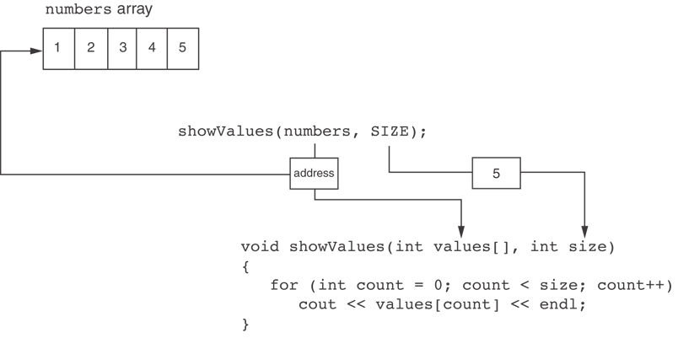
Something Like Pointers: Arrays
The values parameter, in the showValues function, points to the numbers array.
C++ automatically stores the address of numbers in the values parameter.

Slide 9
Something Like Pointers: Reference Variables
We have also worked with something like pointers when we learned to use reference variables. Suppose we have this function: void getOrder(int &donuts) { cout << "How many doughnuts do you want? "; cin >> donuts; }
And we call it with this code: int jellyDonuts; getOrder(jellyDonuts);

Slide 10
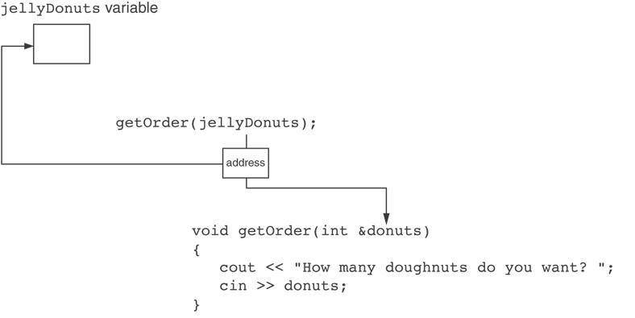
Something Like Pointers: Reference Variables
The donuts parameter, in the getOrder function, points to the jellyDonuts variable.
C++ automatically stores the address of jellyDonuts in the donuts parameter.

Slide 11
Pointer Variables
Pointer variables are yet another way using a memory address to work with a piece of data.
Pointers are more "low-level" than arrays and reference variables.
This means you are responsible for finding the address you want to store in the pointer and correctly using it.

Slide 12
Pointer Variables
Definition:
int *intptr;
Read as:
“intptr can hold the address of an int”
Spacing in definition does not matter:
int * intptr; // same as above
int* intptr; // same as above

Slide 13
Pointer Variables
Assigning an address to a pointer variable:
int *intptr;
intptr = &num;
Memory layout:
num
intptr
25
0x4a00
address of num: 0x4a00

Slide 14
Pointer Variables
Initialize pointer variables with the special value nullptr.
In C++ 11, the nullptr key word was introduced to represent the address 0.
Here is an example of how you define a pointer variable and initialize it with the value nullptr:
int *ptr = nullptr;
Pr9-2.cpp

Slide 15
The Indirection Operator
The indirection operator (*) dereferences a pointer.
It allows you to access the item that the pointer points to. int x = 25; int *intptr = &x; cout << *intptr << endl;
This prints 25.
Pr9-3.cpp

Slide 16
9.3
The Relationship Between Arrays and Pointers

Slide 17
The Relationship Between Arrays and Pointers
Array name is starting address of array
int vals[] = {4, 7, 11};
cout << vals; // displays 0x4a00
cout << vals[0]; // displays 4
4 | 7 | 11
starting address of vals: 0x4a00

Slide 18
The Relationship Between Arrays and Pointers
Array name can be used as a pointer constant:
int vals[] = {4, 7, 11};
cout << *vals; // displays 4
Pointer can be used as an array name:
int *valptr = vals;
cout << valptr[1]; // displays 7
Pr9-5.cpp

Slide 19
Pointers in Expressions
Given:
int vals[]={4,7,11}, *valptr;
valptr = vals;
What is valptr + 1? It means (address in valptr) + (1 * size of an int)
cout << *(valptr+1); //displays 7
cout << *(valptr+2); //displays 11
Must use ( ) as shown in the expressions
1200 valptr | 1201 | 1202 | 1203 | 1204 valptr+1 | 1205 | 1206 | 1207 | 1208 valptr+2 | 1209 | 1210 | 1211

Slide 20
Array Access
Array elements can be accessed in many ways:
Array access method | Example
array name and [] | vals[2] = 17;
pointer to array and [] | valptr[2] = 17;
array name and subscript arithmetic | *(vals + 2) = 17;
pointer to array and subscript arithmetic | *(valptr + 2) = 17;

Slide 21
Array Access
Conversion: vals[i] is equivalent to *(vals + i)
No bounds checking performed on array access, whether using array name or a pointer
Pr9-7.cpp
9_03_Pointers.cpp

Slide 22
9.4
Pointer Arithmetic

Slide 23
Pointer Arithmetic
Operations on pointer variables:
Operation | Example int vals[]={4,7,11}; int *valptr = vals;
++, -- | valptr++; // points at 7 valptr--; // now points at 4
+, - (pointer and int) | cout << *(valptr + 2); // 11
+=, -= (pointer and int) | valptr = vals; // points at 4 valptr += 2; // points at 11
- (pointer from pointer) | cout << valptr–val; // difference //(number of ints) between valptr // and val
Pr9-9.cpp

Slide 24
9.5
Initializing Pointers

Slide 25
Initializing Pointers
int num; int* numptr = &num;
Can initialize at definition time:
int num, *numptr = &num; // pointer to int
int val[3], *valptr = val; // pointer to array
Cannot mix data types:
double cost;
int *ptr = &cost; // won’t work
Can test for an invalid address for ptr with:
if (!ptr) ...
Notes:
(&) Address Operator

Slide 26
9.6
Comparing Pointers

Slide 27
Comparing Pointers
arr[0] | arr[1] | arr[2] | arr[3] | arr[4]
0x5A00 (Addresses) | 0x5A04 | 0x5A08 | 0x5A0C | 0x5A10
The following are all true:
if (&arr[1] > &arr[0]) if (arr < &arr[4]) if (arr == &arr[0]) if (&arr[2] != &arr[3])

Slide 28
Comparing Pointers
Relational operators (<, >=, etc.) can be used to compare addresses in pointers
Comparing addresses in pointers is not the same as comparing contents pointed at by pointers:
if (ptr1 == ptr2) // compares addresses
if (*ptr1 == *ptr2) // compares contents
Notes:
(*) Indirection Operator – Shows contents at that address

Slide 29
9.7
Pointers as Function Parameters

Slide 30
Pointers as Function Parameters
A pointer can be a parameter
Works like reference variable to allow change to argument from within function
Requires:
asterisk * on parameter in prototype and heading void getNum(int *ptr); // ptr is pointer to an int
asterisk * in body to dereference the pointer cin >> *ptr;
address as argument to the function getNum(&num); // pass address of num to getNum
Notes:
(*) indirection operator
(&) reference operator / address operator

Slide 31
Example
void swap(int *x, int *y)
{
int temp;
temp = *x;
*x = *y;
*y = temp;
}
int num1 = 2, num2 = -3;
swap(&num1, &num2);
Pr6-26.cpp
Pr9-11.cpp

Slide 32
Pointers to Constants
If we want to store the address of a constant in a pointer, then we need to store it in a pointer-to-const.
Example: Suppose we have the following definitions: const int SIZE = 6; const double payRates[SIZE] = { 18.55, 17.45, 12.85, 14.97, 10.35, 18.89 };
In this code, payRates is an array of constant doubles.

Slide 33
Pointers to Constants
Suppose we wish to pass the payRates array to a function? Here's an example of how we can do it.
void displayPayRates(const double *rates, int size) { for (int count = 0; count < size; count++) { cout << "Pay rate for employee " << (count + 1) << " is $" << *(rates + count) << endl; } }
The parameter, rates, is a pointer to const double.

Slide 34
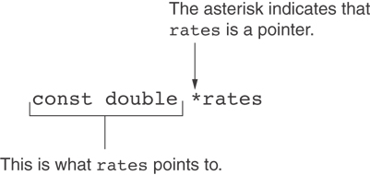
Declaration of a Pointer to Constant

Slide 35
Constant Pointers
A constant pointer is a pointer that is initialized with an address, and cannot point to anything else.
Example int value = 22; int * const ptr = &value;

Slide 36
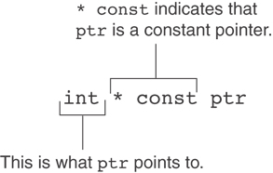
Constant Pointers

Slide 37
Constant Pointers to Constants
A constant pointer to a constant is:
a pointer that points to a constant
a pointer that cannot point to anything except what it is pointing to
Example: int value = 22; const int * const ptr = &value;

Slide 38
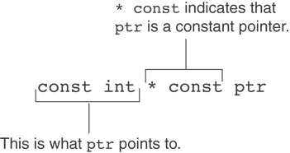
Constant Pointers to Constants

Slide 39
9.8
Dynamic Memory Allocation

Slide 40
Dynamic Memory Allocation
Can allocate storage for a variable while program is running
Computer returns address of newly allocated variable
Uses new operator to allocate memory:
double *dptr = nullptr;
dptr = new double;
new returns address of memory location

Slide 41
Dynamic Memory Allocation
Can also use new to allocate array: const int SIZE = 25; arrayPtr = new double[SIZE];
Can then use [] or pointer arithmetic to access array:
for(i = 0; i < SIZE; i++)
*arrayptr[i] = i * i;
or
for(i = 0; i < SIZE; i++)
*(arrayptr + i) = i * i;
Program will terminate if not enough memory available to allocate

Slide 42
Releasing Dynamic Memory
Consider this function:
void grabMemory()
{
const int SIZE = 100;
// Allocate space for a 100-element
// Array of integers
int *iptr = new int[SIZE];
}
When the function ends, the pointer is removed, but the data is still stored in memory. This data is inaccessible since there is no pointer to it. This is called a memory leak.

Slide 43
Releasing Dynamic Memory
Use delete to free dynamic memory:
delete fptr;
Use [] to free dynamic array:
delete [] arrayptr;
Only use delete with dynamic memory!
Pr9-14.cpp

Slide 44
9.9
Returning Pointers from Functions

Slide 45
Returning Pointers from Functions
Pointer can be the return type of a function:
int *newNum();
The function must not return a pointer to a local variable in the function.
A function should only return a pointer:
to data that was passed to the function as an argument, or
to dynamically allocated memory
Pr9-15.cpp

Slide 46
9.10
Using Smart Pointers to Avoid Memory Leaks

Slide 47
Using Smart Pointers to Avoid Memory Leaks
In C++ 11, you can use smart pointers to dynamically allocate memory and not worry about deleting the memory when you are finished using it.
Three types of smart pointer:
Must #include the memory header file:
In this book, we introduce unique_ptr:
unique_ptr
shared_ptr
weak_ptr
#include <memory>
unique_ptr<int> ptr( new int );

Slide 48
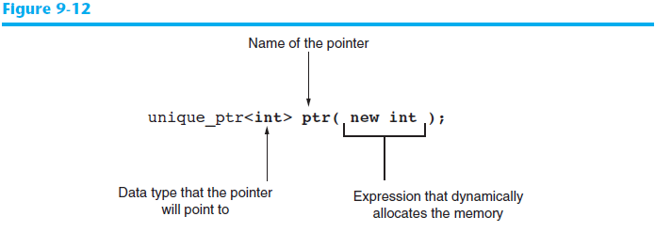
Using Smart Pointers to Avoid Memory Leaks
The notation <int> indicates that the pointer can point to an int .
The name of the pointer is ptr .
The expression new int allocates a chunk of memory to hold an int.
The address of the chunk of memory will be assigned to ptr.

Slide 49
Using Smart Pointers to Avoid Memory Leaks
Now, go back to this function:
void grabMemory()
{
const int SIZE = 100;
// Allocate space for a 100-element
// Array of integers
unique_ptr<int> iptr(new int);
}
This dynamically allocates memory. When the function ends, the pointer is removed, and the data is cleared from memory.
Pr9-17.cpp

